Slide 1

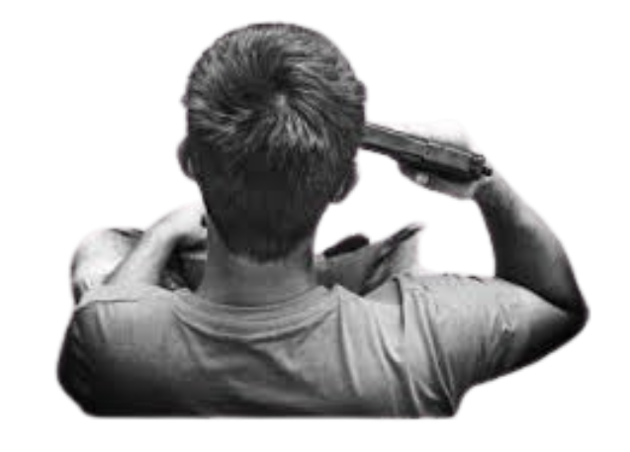
A Visual Story of Suicides in INDIA
Team : 14
GUIDED BY : Prof. Bhaskar Chaudhury

Slide 2

"Not every wound is visible. Not every goodbye is spoken. Every number in this dataset was once a life, a story, a voice unheard”

Slide 3
Introduction:
Suicide is among the top 3 causes of death in youth worldwide.
Acc. to WHO nearly 1 million annually die due to suicide and
1 attempt every 3 seconds happens on average.
India ranks 49rd in descending order of rates of suicide with a rate of 14.04/100,000 reported in 2019

Slide 4
Dataset Overview :
STATES: All Indian States and Union Territories
YEARS: 2001-2012
TYPE_CODE : Causes, Educational_Status, Means_Adopted, Professional_Profile, Social_Status
TYPE: Sub categories of type_code
GENDER: Male, Female
AGE_GROUP: 0-14 , 15-29, 30- 44, 45 – 59, 60+
TOTAL : No. of Suicides
SOURCE : https://www.kaggle.com/datasets/rajanand/suicides-in-india

Slide 5

Suicides over the Years

Slide 6
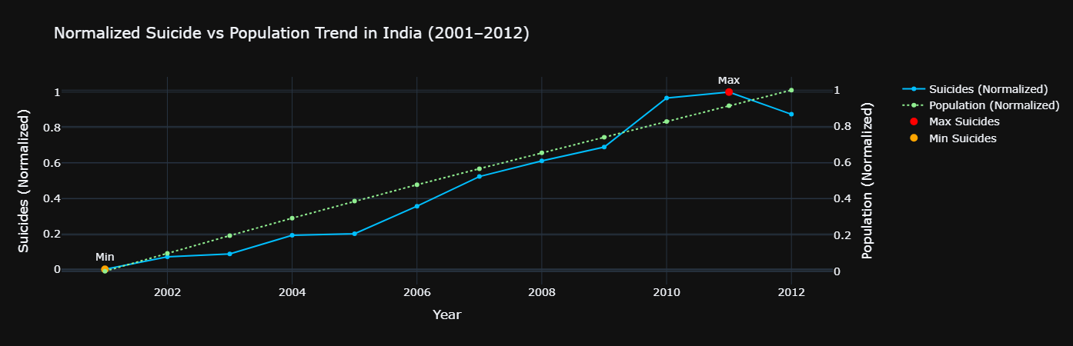
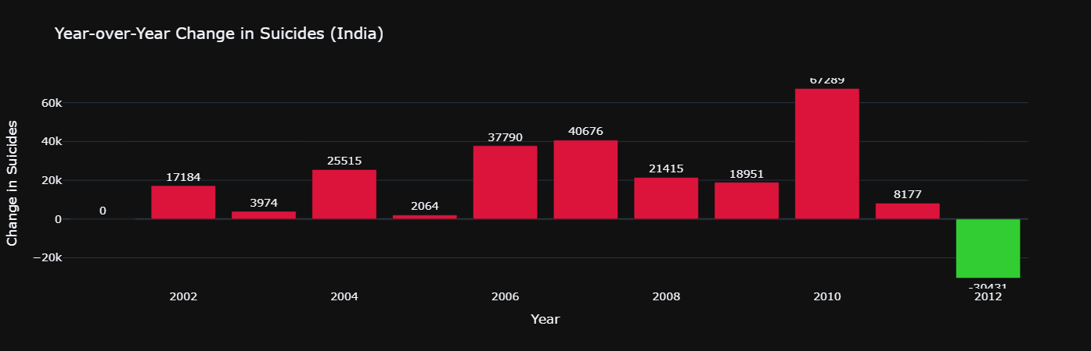
Suicide cases in INDIA have exhibited a increasing trend over the past decade
Overall there has been significant increase in trendline till 2011 , though there has been slight drop in 2012.
It shows the variation in suicide cases of following year compared to the previous one.

Slide 7
What can we say about the Age of the victims ?

Slide 8
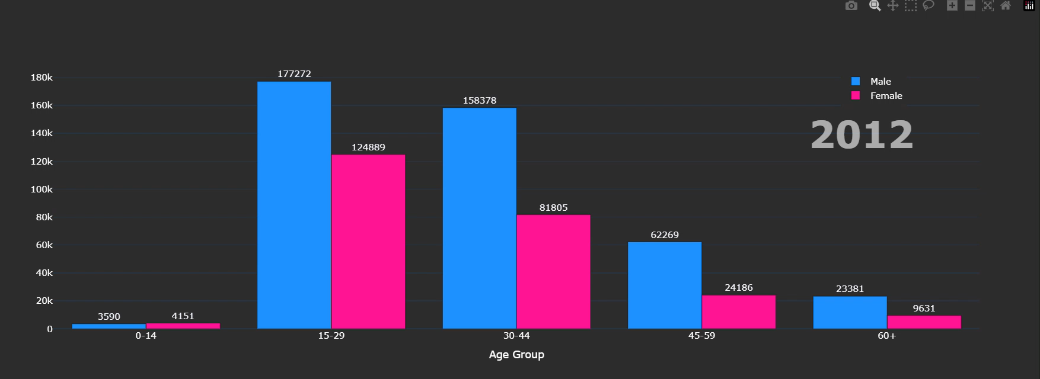
Analysis of Suicides in each Age Group
A concerning trend among youth / young adults and middle-aged People is observed
Across all age groups, males consistently show higher suicide numbers compared to females except one age group

Slide 9
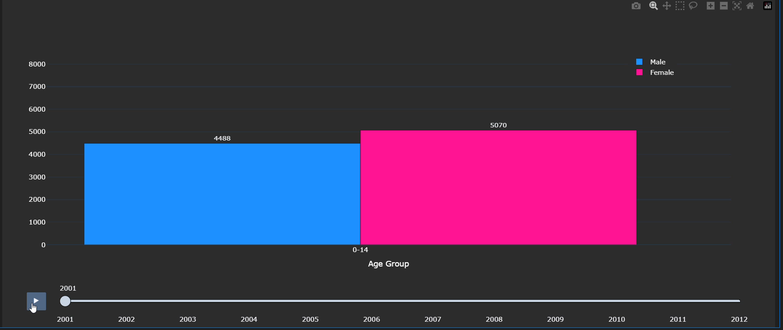
Age Group 0-14 says otherwise
Females consistently show higher suicide stats compared to Males since decades

Slide 10
Where these Suicides happened the most ??

Slide 11

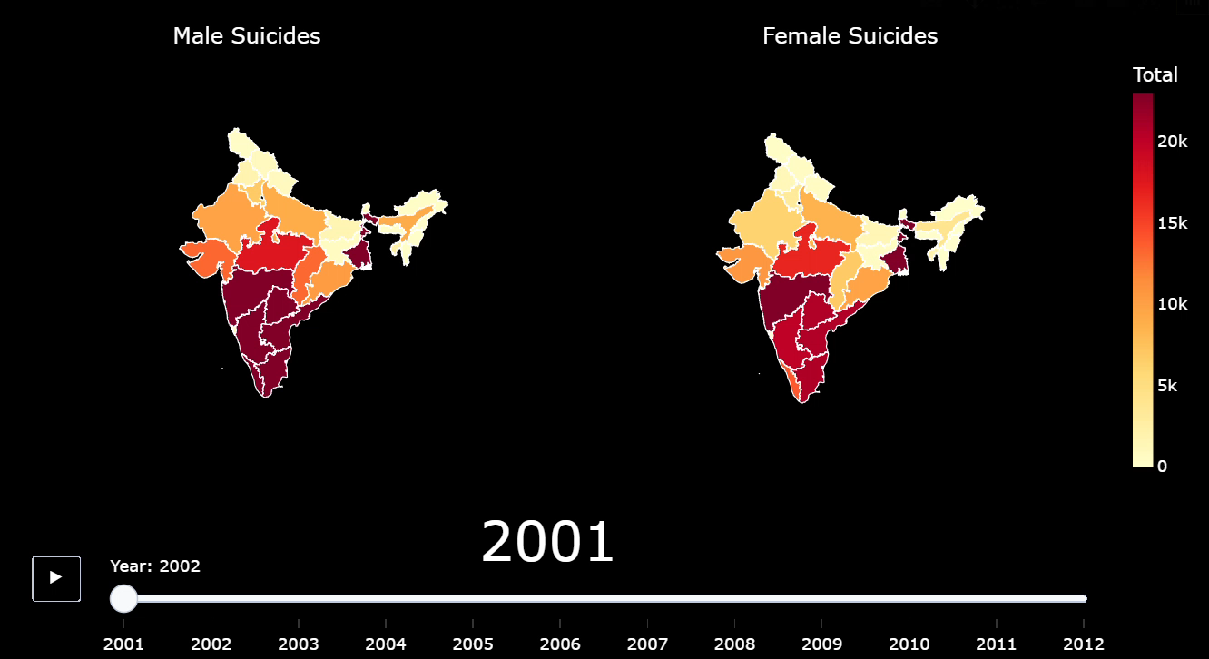
States with most Suicides, split by Gender
As the years passed , Female Suicide became visible in central part of the India ,and Male suicides increased in central and Western part of India too.
South region is common and consistent for giving higher cases of Suicides in Male and Female.
100% Literacy rate ??

Slide 12
Is there any angle of Education level on Suicides ?

Slide 13
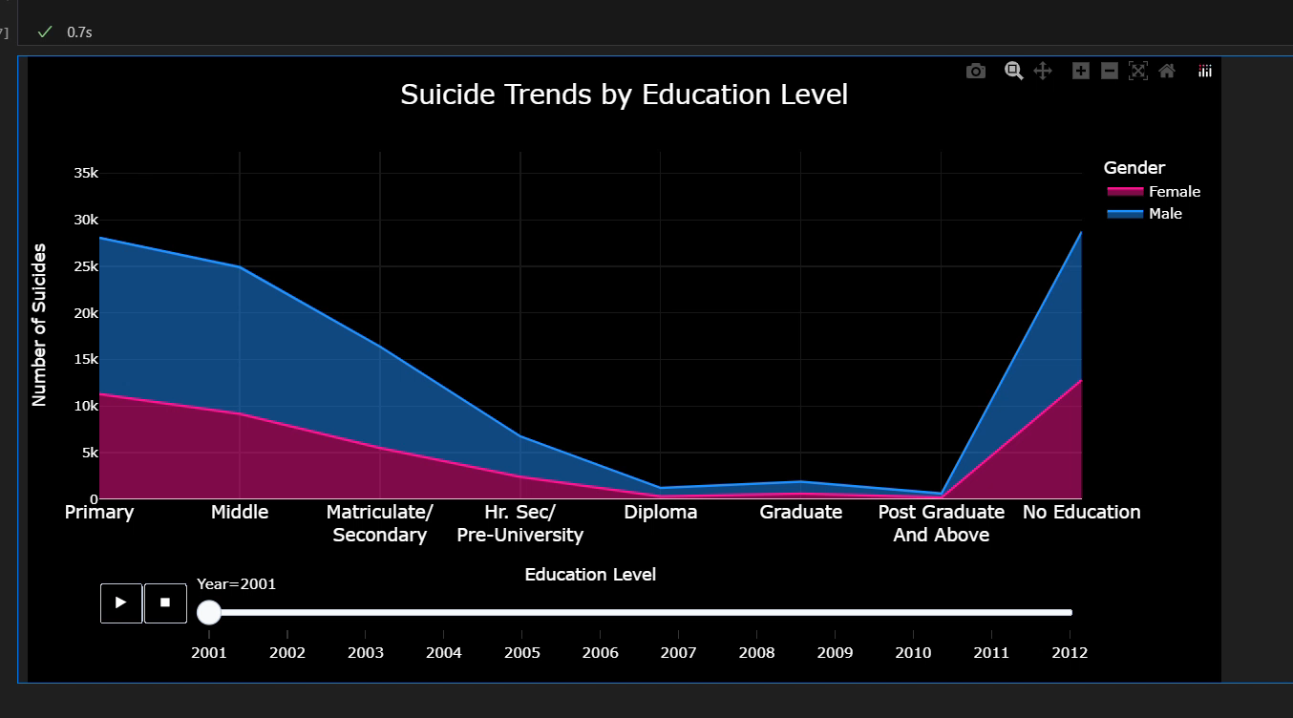
Education-Level of Suiciders
Suicide risk is the Highest among people with Lower level for education

Slide 14
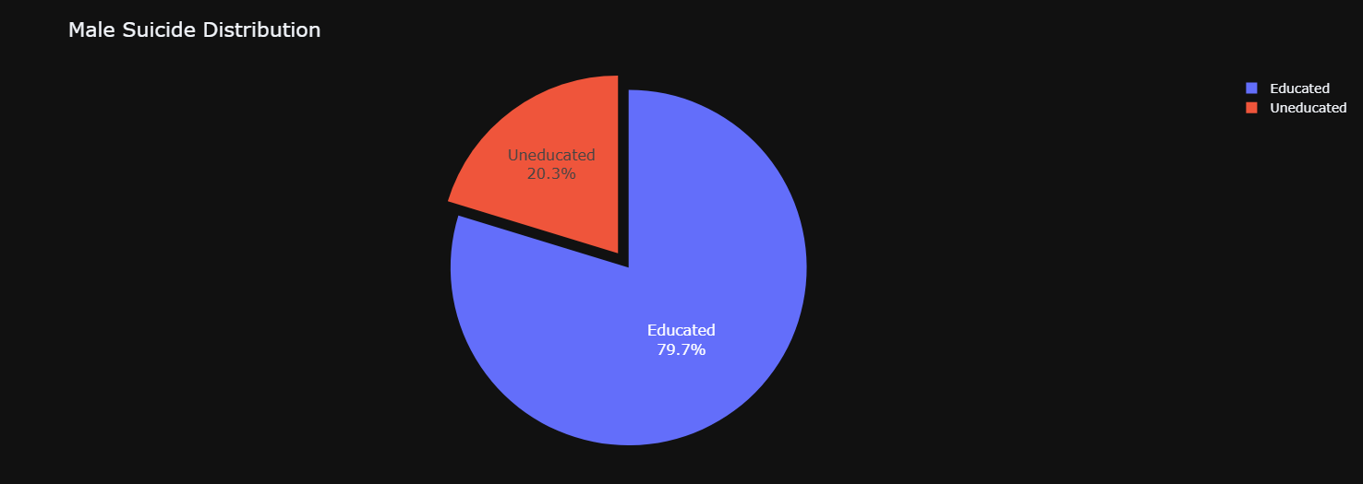
Proportion of Educated and Uneducated people Suiciding Among Males

Slide 15
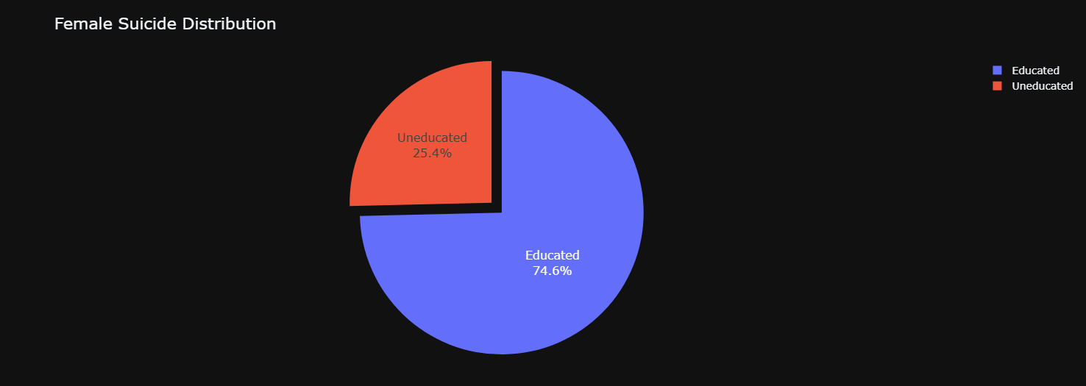
Proportion of Educated and Uneducated people Suiciding Among Females

Slide 16
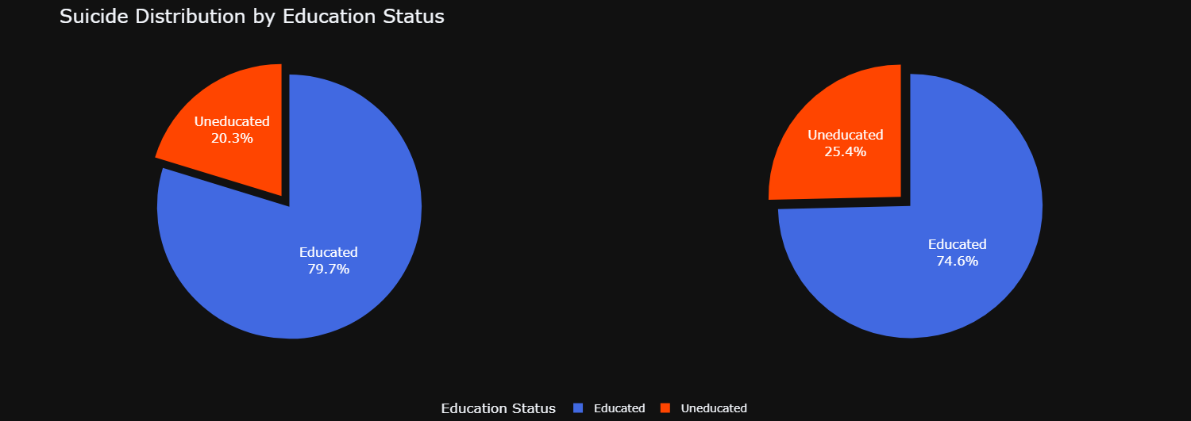
Proportion of Educated and Uneducated people Suiciding Among Males & Females
Among females, a higher proportion of suicides are from uneducated women i.e. One-Fourth , whereas among males, uneducated men account for a smaller share One-Fifth
This suggests that lack of education may be a more significant contributing factor to suicide among females compared to males.
higher suicide rate among educated men (79.7%) may reflect higher financial pressure in Men then Women

Slide 17
What Profession Profiles leads to most Suicides ?

Slide 18
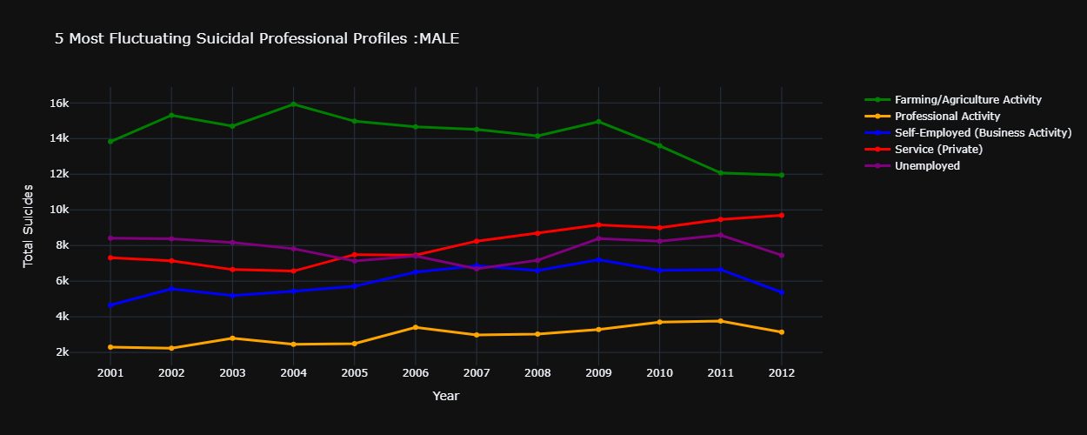
Profession Profiles of Male victims

Slide 19
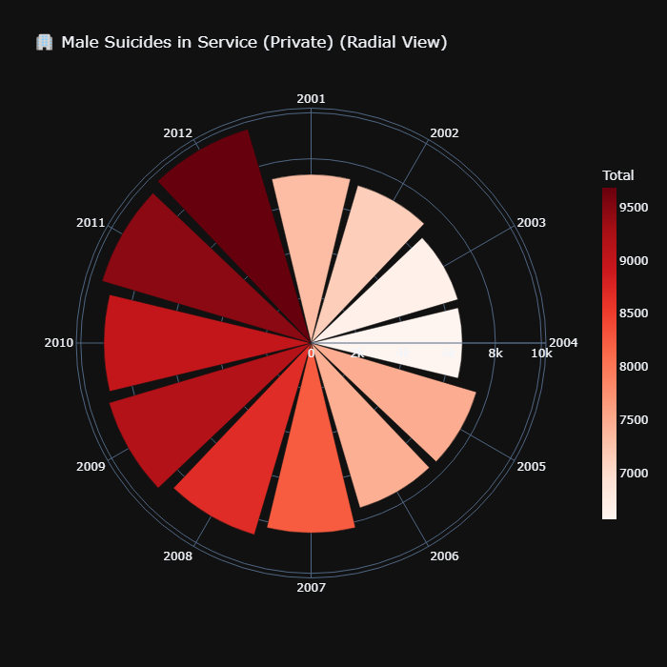
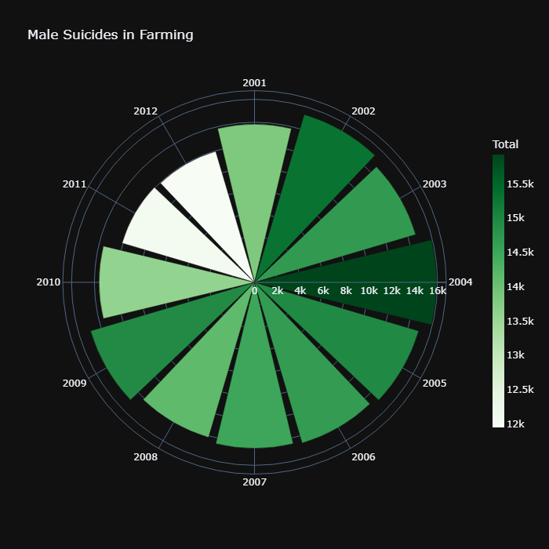
Comparing two Professions for Male

Slide 20
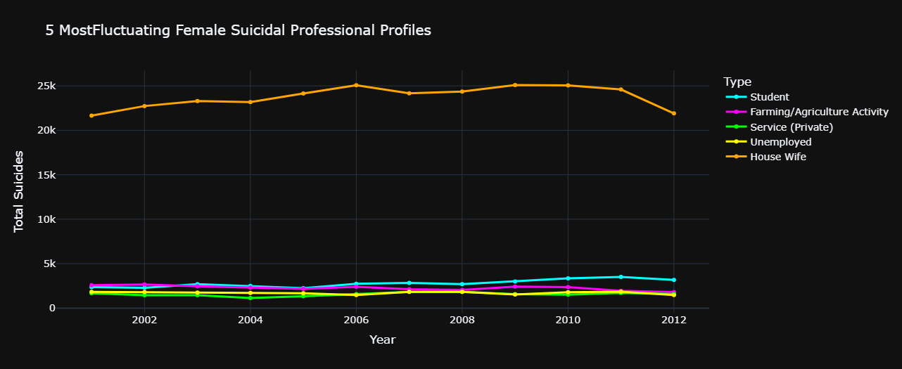
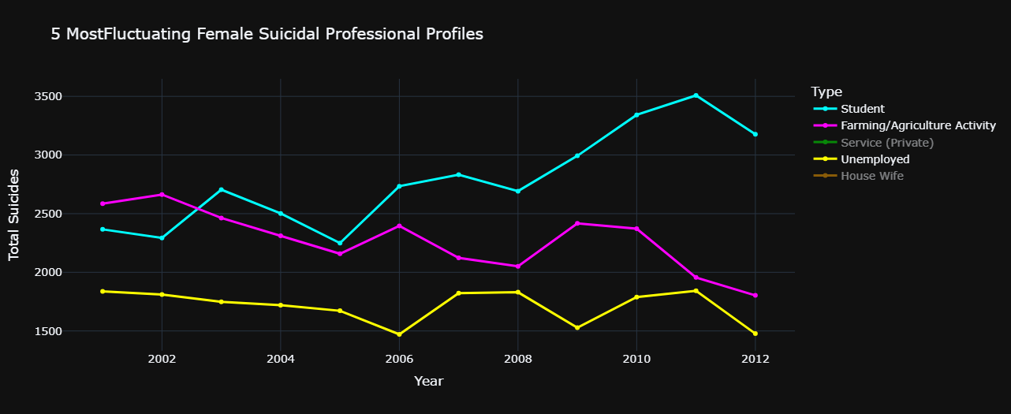
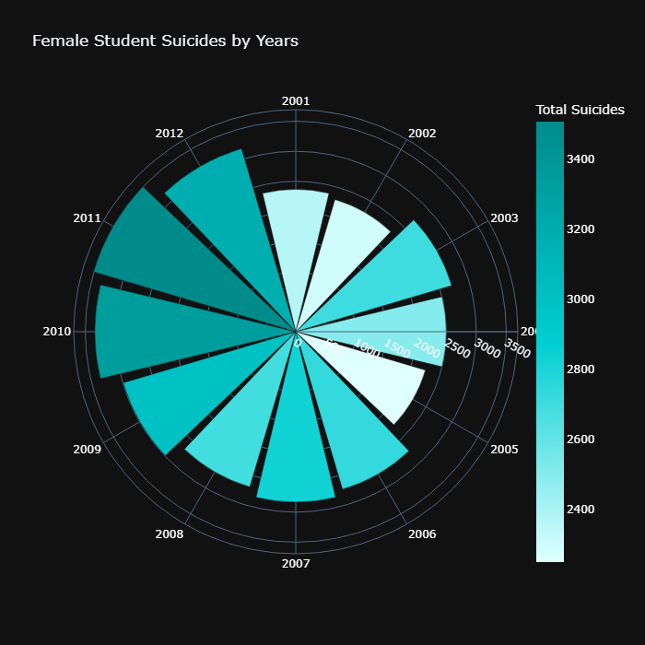
Professional Profiles of Female victims

Slide 22
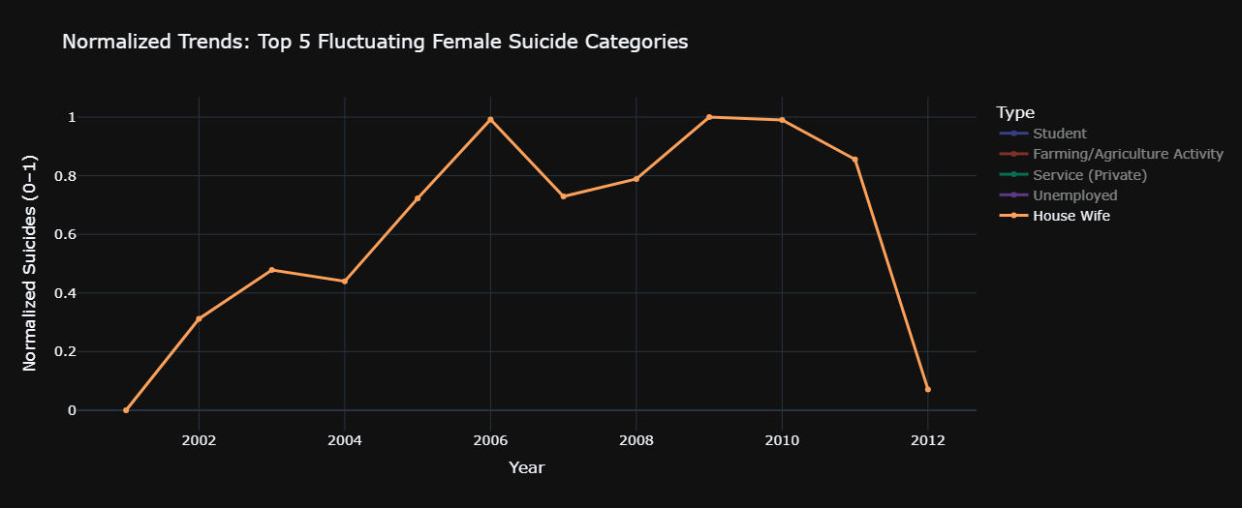

Slide 23
Social Status analysis of the Victims

Slide 24
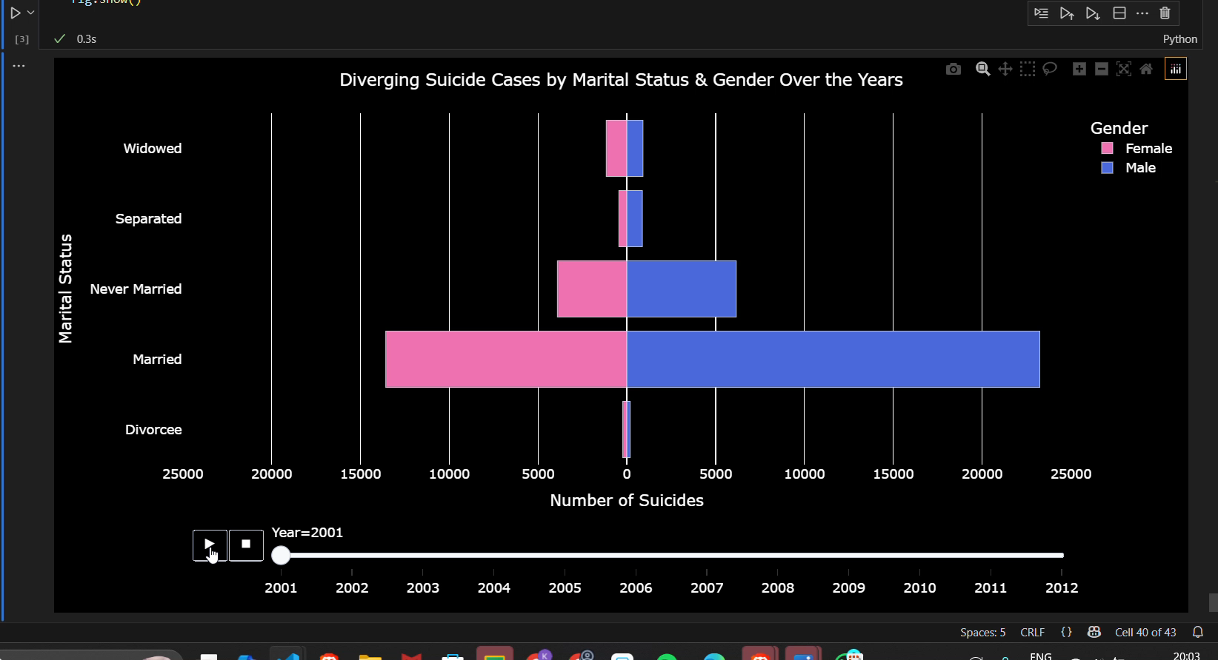
Contrary to the belief that marriage offers protection against suicide, data from India shows higher Suicide rates among married individuals, especially men.

Slide 25
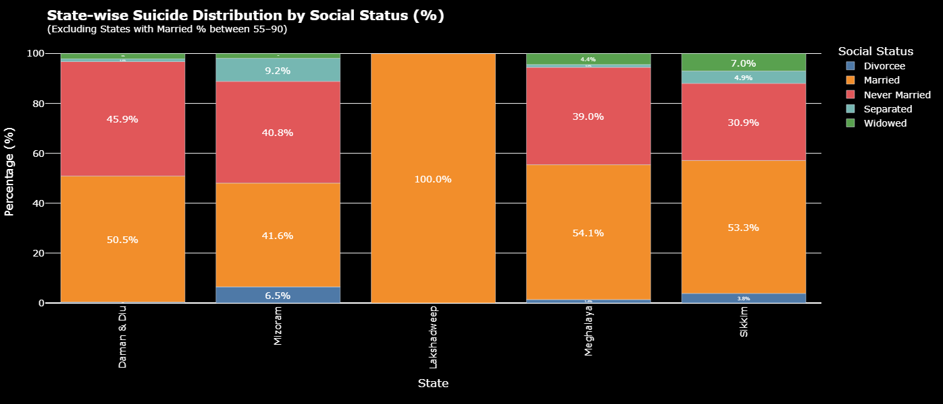
Across states, marital status in suicide cases varies widely. Lakshadweep reports only married individuals, while places like Daman & Diu and Mizoram show a more balanced mix of married and never married. Sikkim stands out with the most diverse spread, including all marital categories.

Slide 26
What Could have been the Causes of Suicides ??

Slide 27
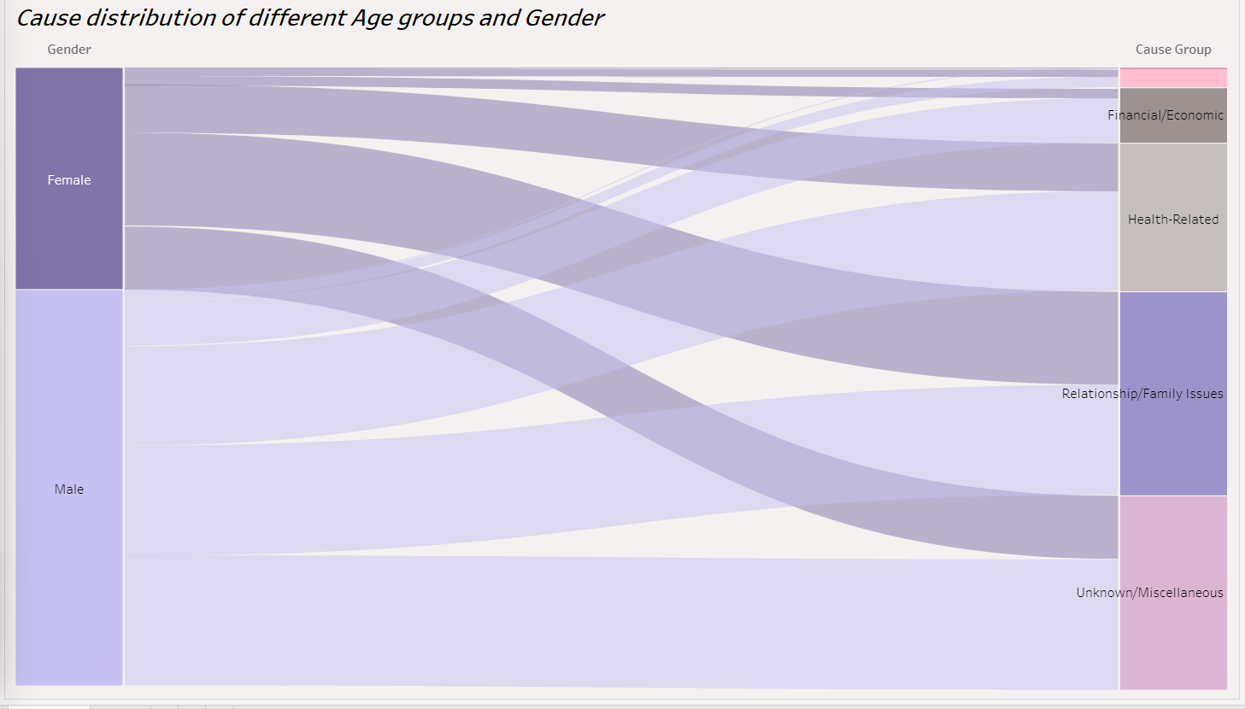
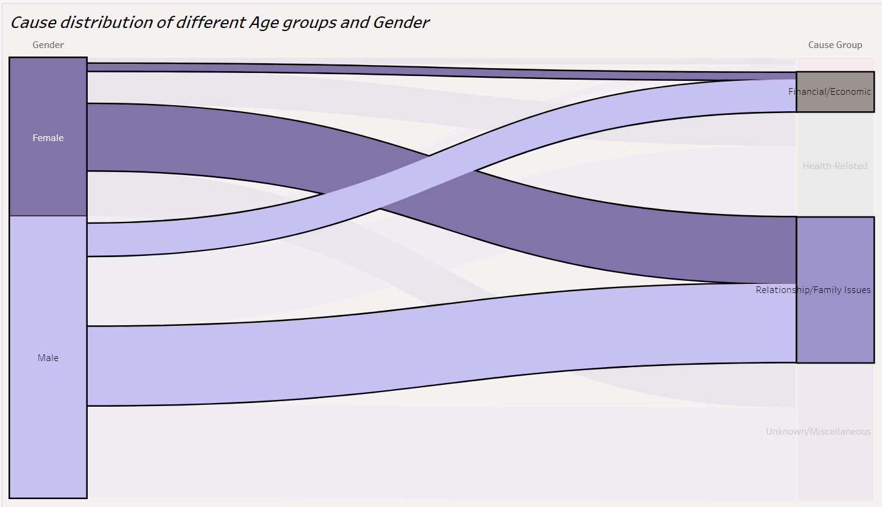

Slide 28
The graph depicts that Family and relationship issues are common in both Male and Female equally
But !! Financial Issues are more handled by Men alone than Women

Slide 29
What were the Means adopted by the Victims?

Slide 30
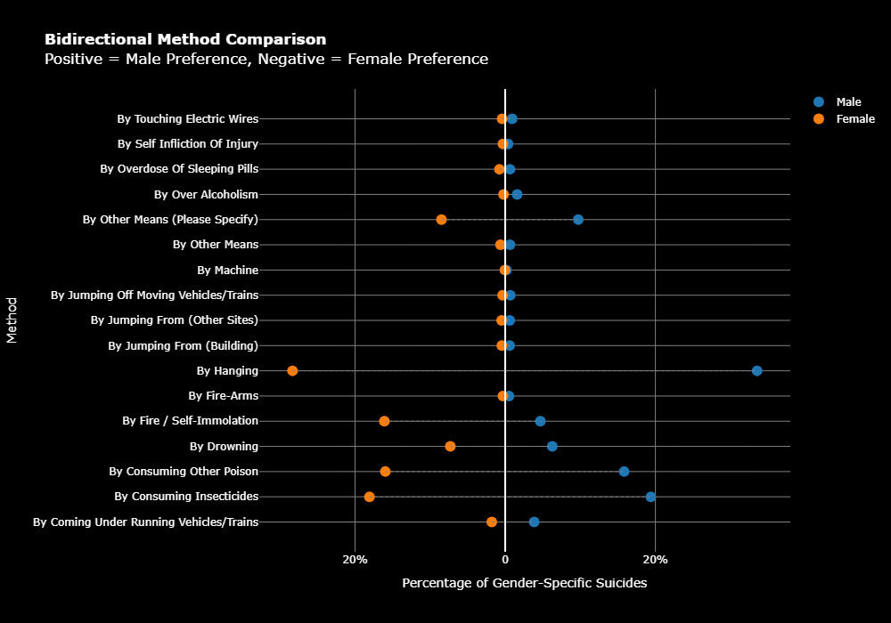
Suicide methods preferred by both the genders
Graph shows gender-based differences in suicide methods.
Women have higher rates by fire/self-immolation.
while men more often die by hanging or under vehicles

Slide 31

CONCLUSION
Gender Differences
Age Vulnerability
State-wise Variation
Occupation & Education
Marital Status Insight
Need for Action

Slide 32
Prevention
Address Root Causes
Medical & Psychological
Protect High-Risk Groups
Community & Policy Action
Media & Culture Change

Slide 33
Thank You
• Yashraj Sinh
• Krisha Sompura
• Milan Nagvadiya
• Sheetal Jain
• Pragnya Dandavate

